Slide 1

Capstone Project - 3
Team 4: Airline Passenger Referral Prediction
Team Members
Narra Sai Keerthana Reddy
Dristanta Nirola
F M Nurul Huda Pathan
Rajat Pal

Slide 2
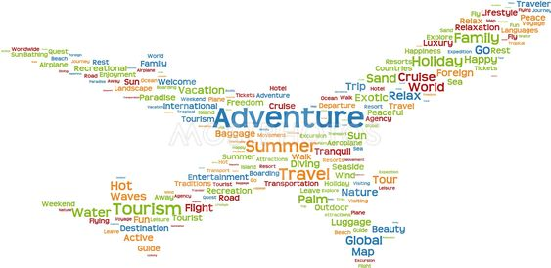
Content:
Problem statement
Inferences from visualization of features
Feature engineering
Building Classifier Models
Comparing Different Models Performance
Conclusion
Improvement
Challenges

Slide 3
Problem Statement:
Data is scraped in Spring 2019 from Skytrax website.
Data includes airline reviews from 2006 to 2019 for popular airlines around the world with multiple choice and free text questions.
The main objective is to predict whether passengers will refer the airline to their friends.

Slide 4
Data Summary:
Data set name-- data_airline_reviews.xlsx
Shape-- (131895,17)
Columns--
['airline', 'author', 'review_date', 'customer_review', 'aircraft', 'traveller_type', 'cabin', 'route', 'date_flown', 'overall_score',
'seat_comfort', 'cabin_service', 'food_bev', 'entertainment', 'ground_service', 'value_for_money',
'recommended']

Slide 5
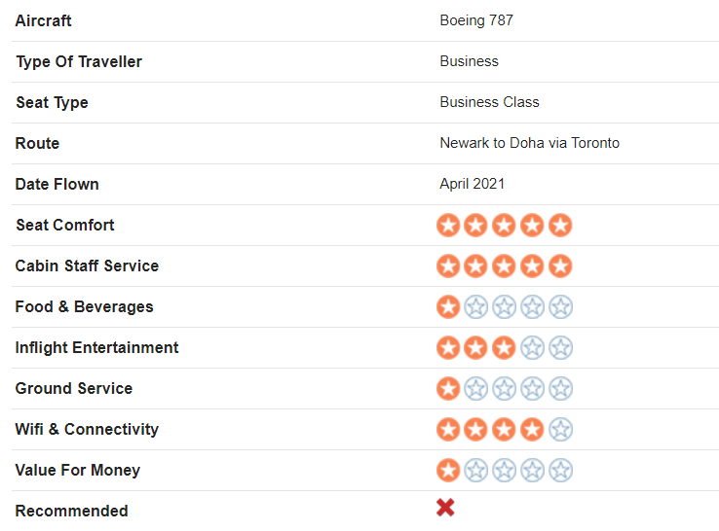
Understanding Data:
Person feedback left by confirmed customers of most of the world's major airlines make up the dataset.

Slide 6
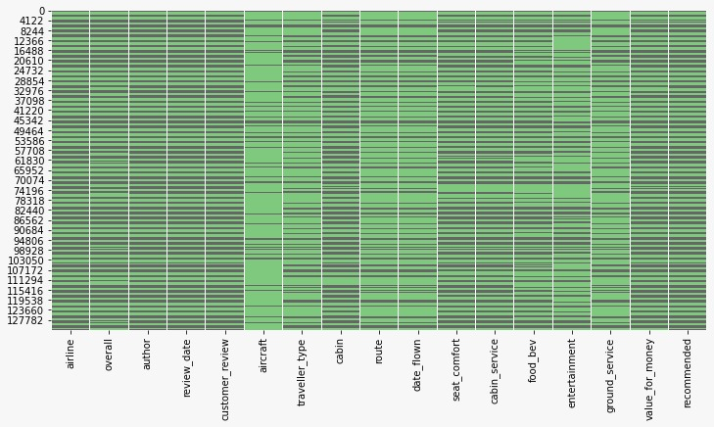
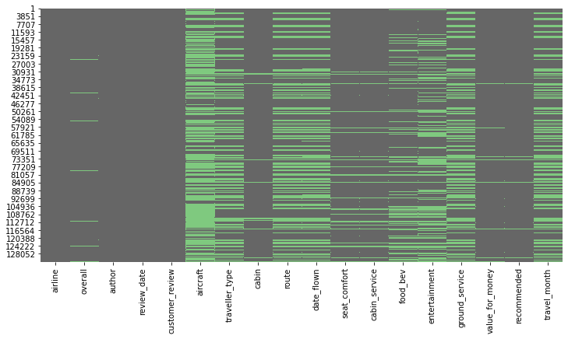
Data Cleaning:
NAN values in alternate rows
Dropped 70711 duplicate rows(53.61% of total rows)
Left with rows 61183
Fig: Before removing the alternative rows with all NaN values.
Fig: After removing the alternative rows with all NaN values.

Slide 7
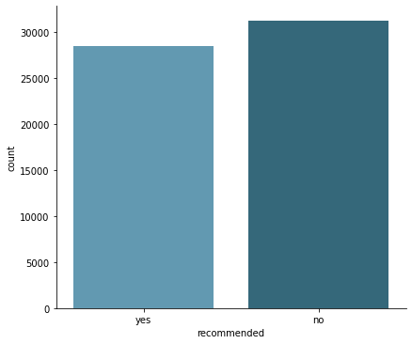
Checking Imbalance in Target Column:
Dataset given is not under the influence of imbalances

Slide 8
Inferences from Visualization of Features:
Top 5 aircraft types and airlines
Which season of a year people prefer to travel and what are the top 5 routes?
Do people travel in group and which cabin class, they prefer?
How Overall rating relates to passenger Recommendation?
Top words in passenger Reviews
Correlation among different rating types

Slide 9
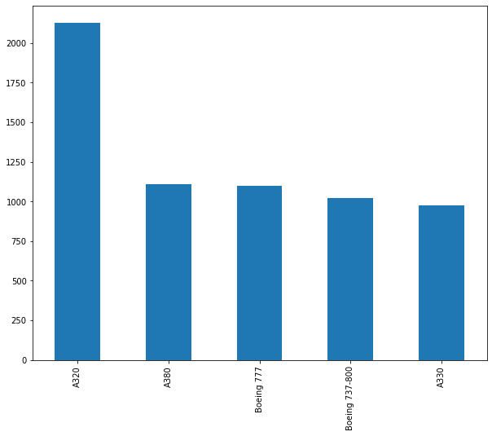
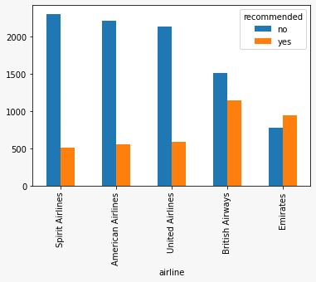
Top 5 aircraft types and airlines:

Slide 10
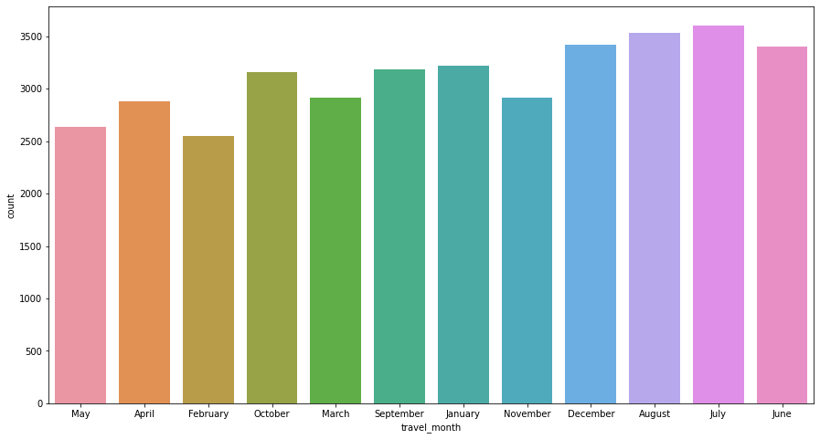
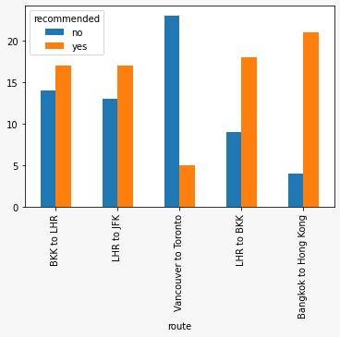
Which season of a year people prefer to travel and what are the top 5 routes?

Slide 11
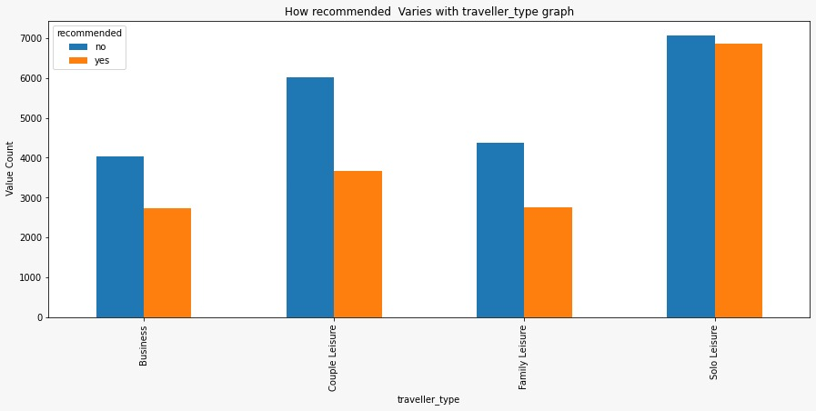
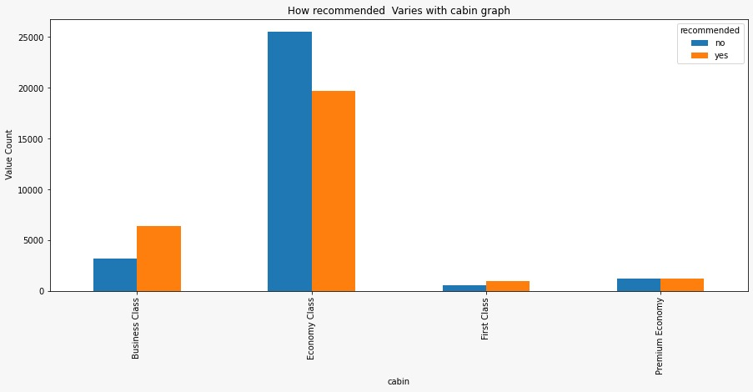
Do people travel in group and which cabin class, they prefer?

Slide 12
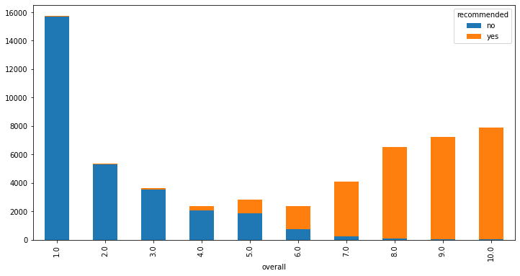
How Overall rating relates to passenger Recommendation?

Slide 13
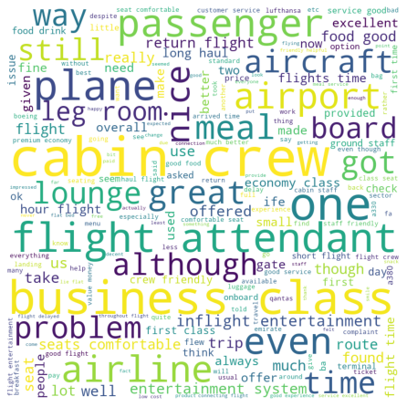
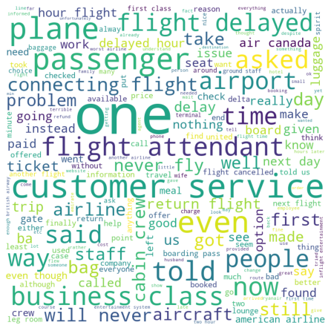
Top words in passenger Reviews
Fig: Word cloud Recommended
Fig: Not Recommended

Slide 14
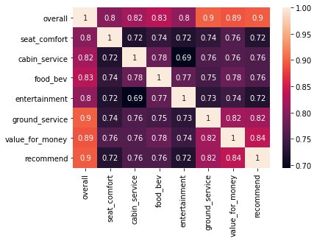
Correlation among different rating type features and target feature:

Slide 15
Imputation of missing values and Feature Engineering:
Imputation of missing values in target variable.
Imputation of missing values in Independent variable.
Handling categorical variables and Date.
Handled anomaly in Target variable.
Handling text column:
Bag of word(BoW)
Tf-IDF
Sentiment VADER

Slide 16
Imputation of missing values in Target variable
1451 missing values in the target variable.
Imputation using simple model with help of if and else statement on overall feature.
Imputation using Review column by building a Naive Bayes model with Review column and Target columns.
Ultimate model is chosen for the one with Overall feature as it gives higher accuracy.

Slide 17
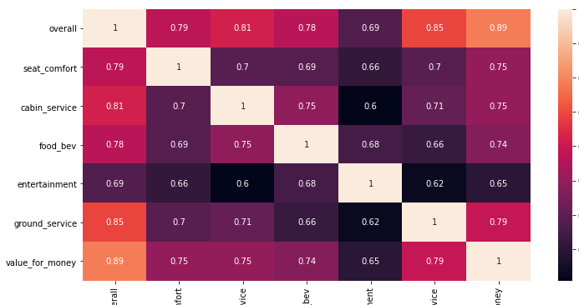
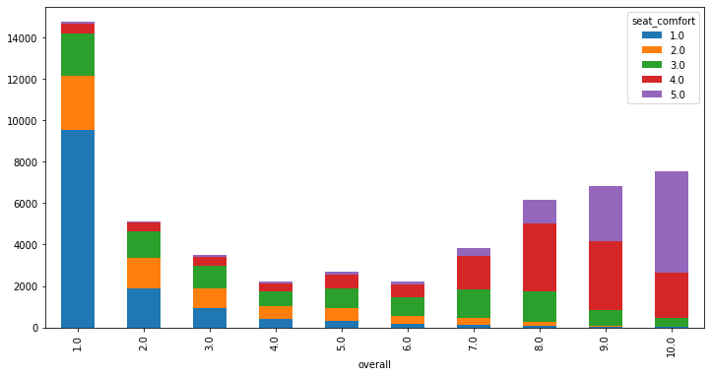
Imputation of missing values in Independent variable:
Imputation of missing values in sub-rating columns using overall column value.
Imputation of missing values in overall columns using average sub-rating column value.

Slide 18
Handling categorical variables and Date:
Categorical features and date includes ['airline', 'author', 'review_date','aircraft', 'traveller_type', 'cabin', 'route', 'date_flown', 'travel_month']
Drop categorical variables with large number of unique values.
Performed One hot encoding for categorical variables.
Dropped features with more than 60% null values.
Date was split into months and day columns.

Slide 19
Handling text column:
BoW: Create a count vector of each of the words in the customer reviews.
TF-IDF: Create weighted vector using term-frequency and Inverse of the document frequencies to represent each of the reviews.
Review Sentiment (VADER): VADER (Valence Aware Dictionary and sEntiment Reasoner) is a rule-based sentiment analysis tool that is specifically attuned to sentiments expressed in social media. VADER uses a combination of A sentiment lexicon is a list of lexical features (e.g., words) which are generally labeled according to their semantic orientation as either positive or negative. VADER not only tells about the Positivity and Negativity score but also tells us about how positive or negative a sentiment is.

Slide 20
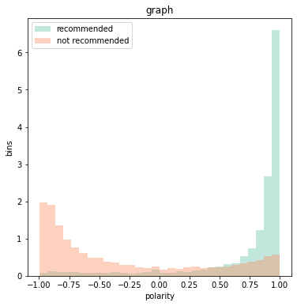
Review polarity vs recommend:
Fig: Histogram polarity
The histogram shows the correlation of the review polarity and the recommends for the dataset.

Slide 21
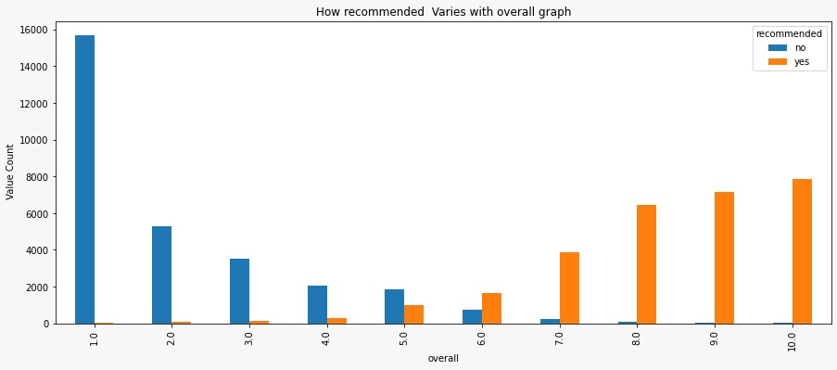
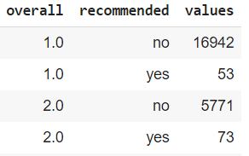
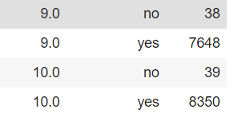
Handling Anomaly in Target variable:
Fig: Before anomaly treatment
Datapoint having overall rating 1.0 and 2.0 and still getting recommended as yes are considered Anomaly.
Similarly datapoint having overall rating 9.0 and 10.0 and still getting recommended as No are considered Anomaly.

Slide 22
Train Test Split:
Dataset size after cleaning and featurization (61183,97)
Used 80% of data in training and 20% on test.
Train data set has shape-(48946, 97) and Test dataset has shape-(12237, 97)

Slide 23
Building Classifier Models:
Models used-
Logistic Regression
LinearSVC
MultinomialNB
DecisionTreeClassifier
Random Forest
GradientBoostingClassifier

Slide 24
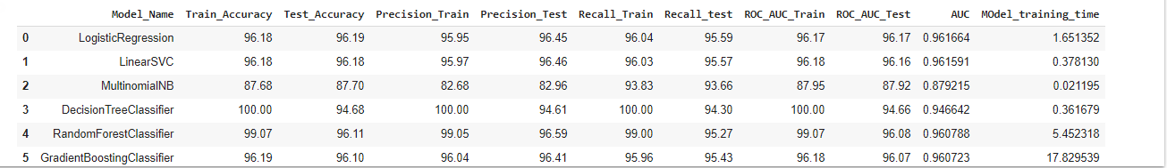
Different Classifier Models’ Performance:
Logistic Regression is the best performing model in term of accuracy as well as precision and recall value on test set

Slide 25
Cross validation techniques used
Used K-Fold and RepeatedKFold techniques in LR model
Implemented K=10 fold for KFold and K=4 for RepeatedKFold.
Each fold gave an accuracy of above 95% above.

Slide 26
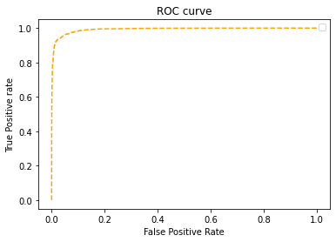
Model performance visualization using ROC-AUC curve

Slide 27
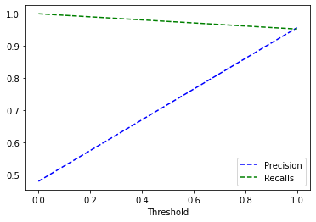
Precision and recall for different threshold values
Low value of threshold,higher the recall.

Slide 28
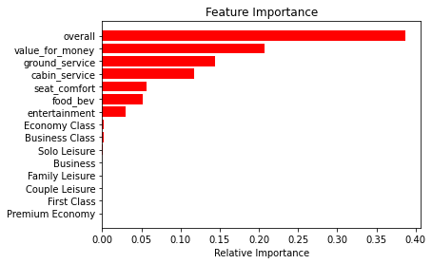
Feature Importance

Slide 29
Conclusion
We have built classifier models using 6 different types of classifiers and all these are able to give accuracy of more than 95%.
The most important features are Overall rating and Value for money that contribute to a model's prediction.
The classifier model developed will enable airlines ability to identify impactful passengers who can help in bringing more revenue.

Slide 30
Improvement
Extra features such as flight delay time, pilot experience can be added to improve more accurate prediction.
Increasing the data size.
Working on removing more anomaly from data.

Slide 31
Challenges
Imputing target variable missing values.
Anomaly in the Dataset.
Limited data.
Chance of overfitting.
Most of the engineered features was not much improving the model accuracy.

Slide 32
Q & A

